Slide 1
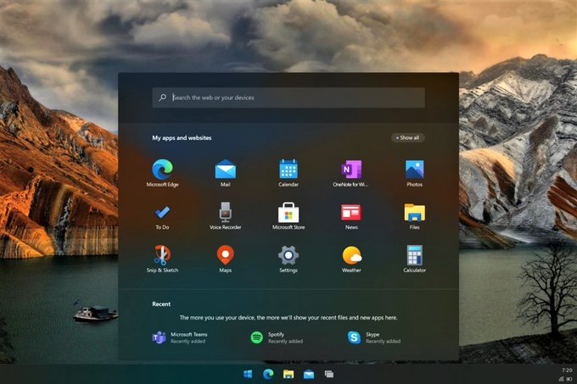
This Photo by Unknown Author is licensed under CC BY-SA-NC

Slide 2
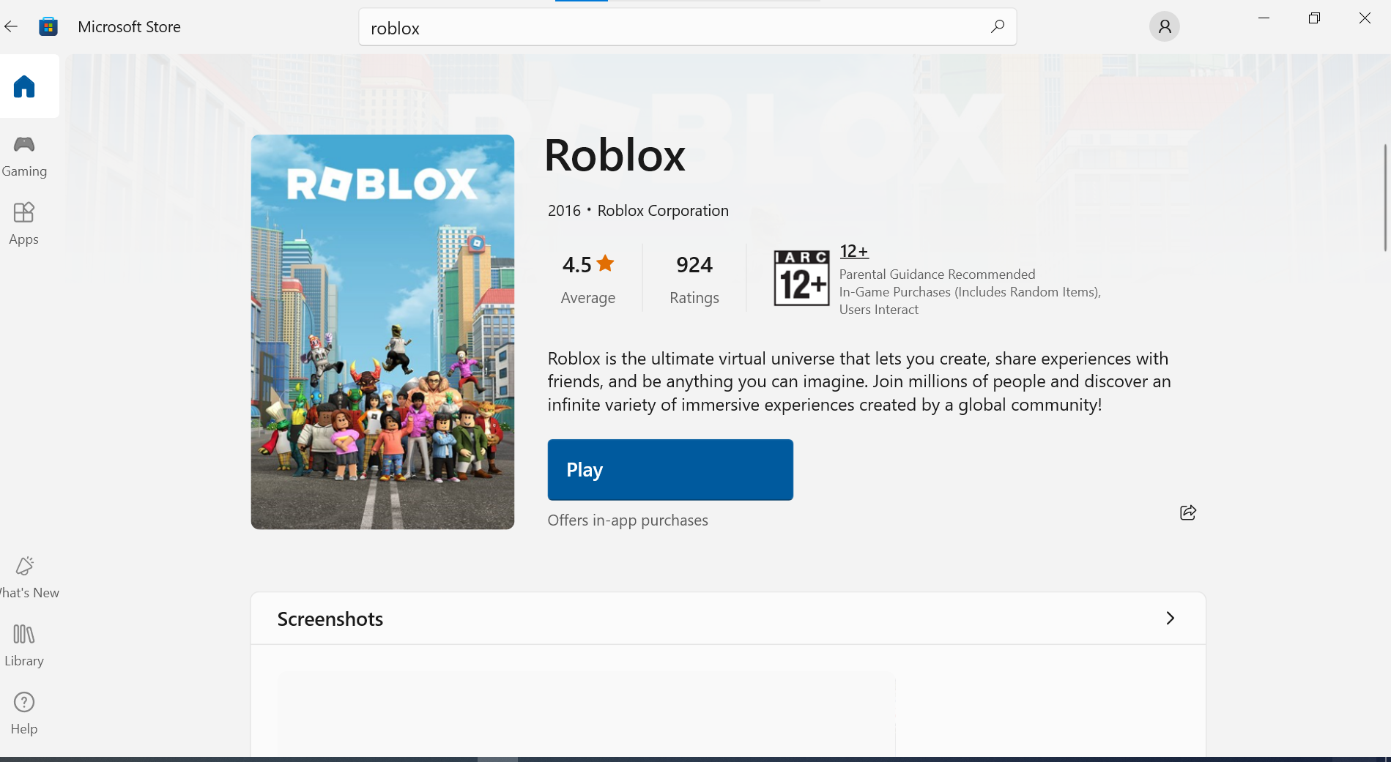
This Photo by Unknown Author is licensed under CC BY-SA-NC

Slide 3

This Photo by Unknown Author is licensed under CC BY-SA-NC

Slide 4
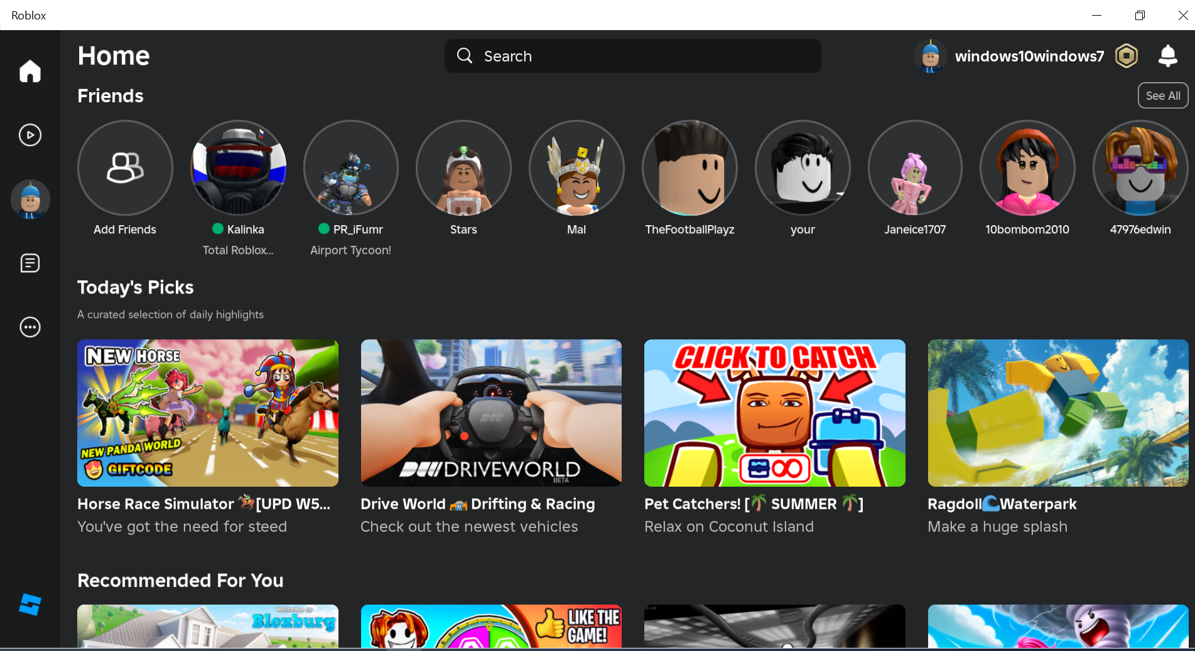

Slide 5
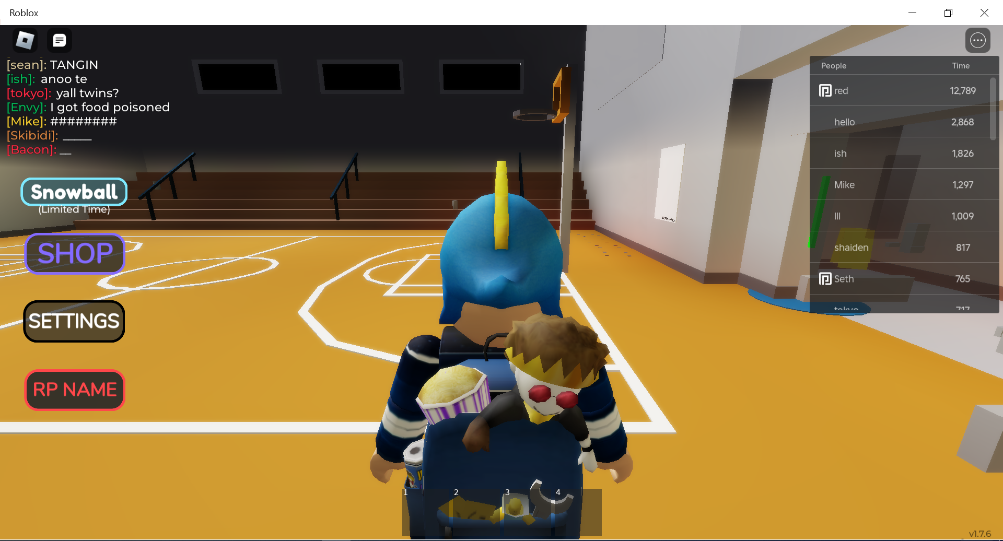

Slide 6
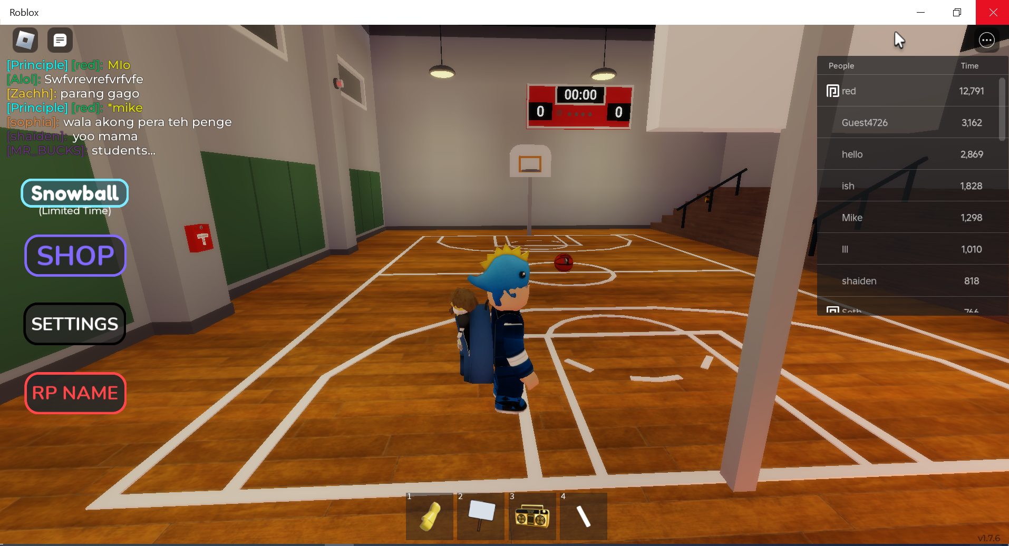
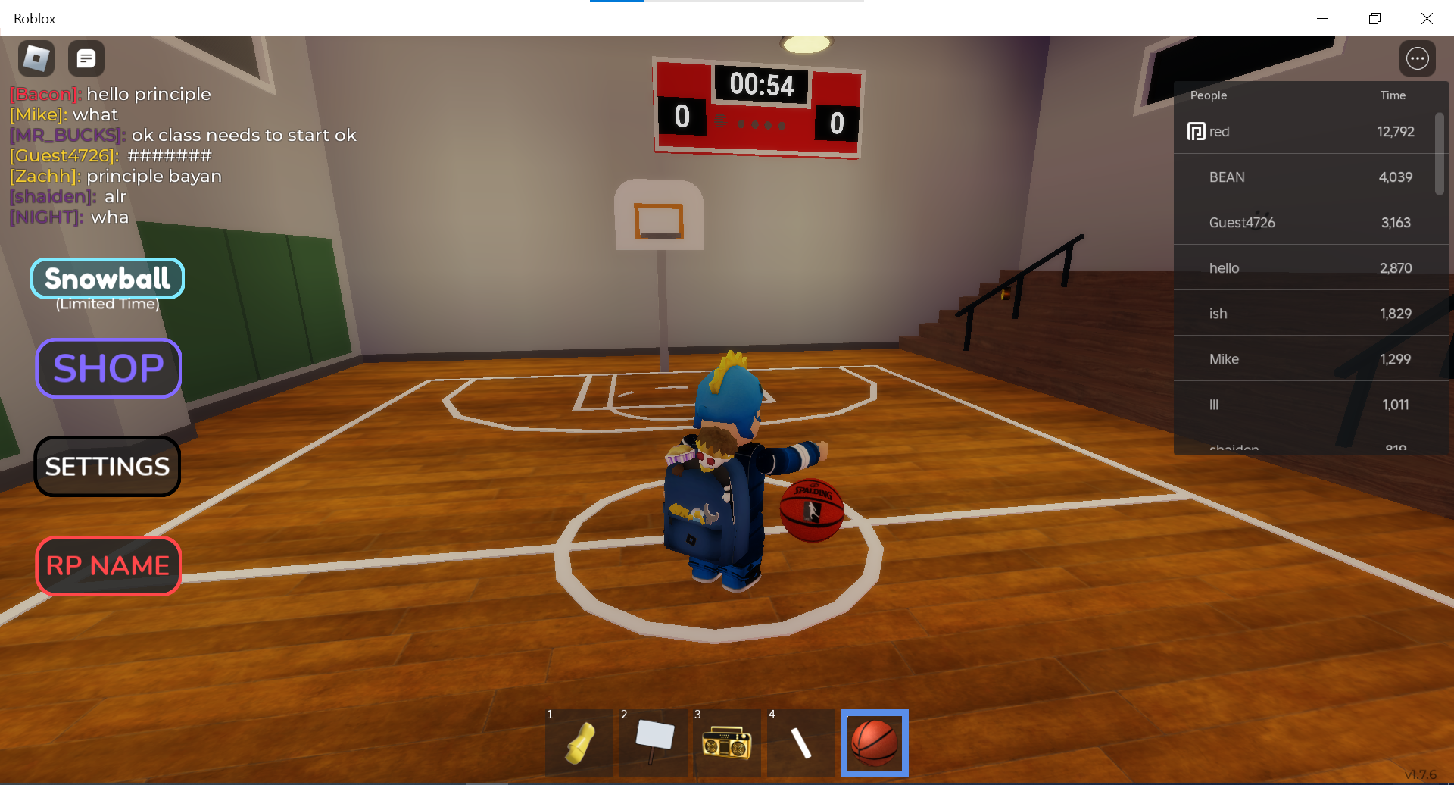

Slide 7
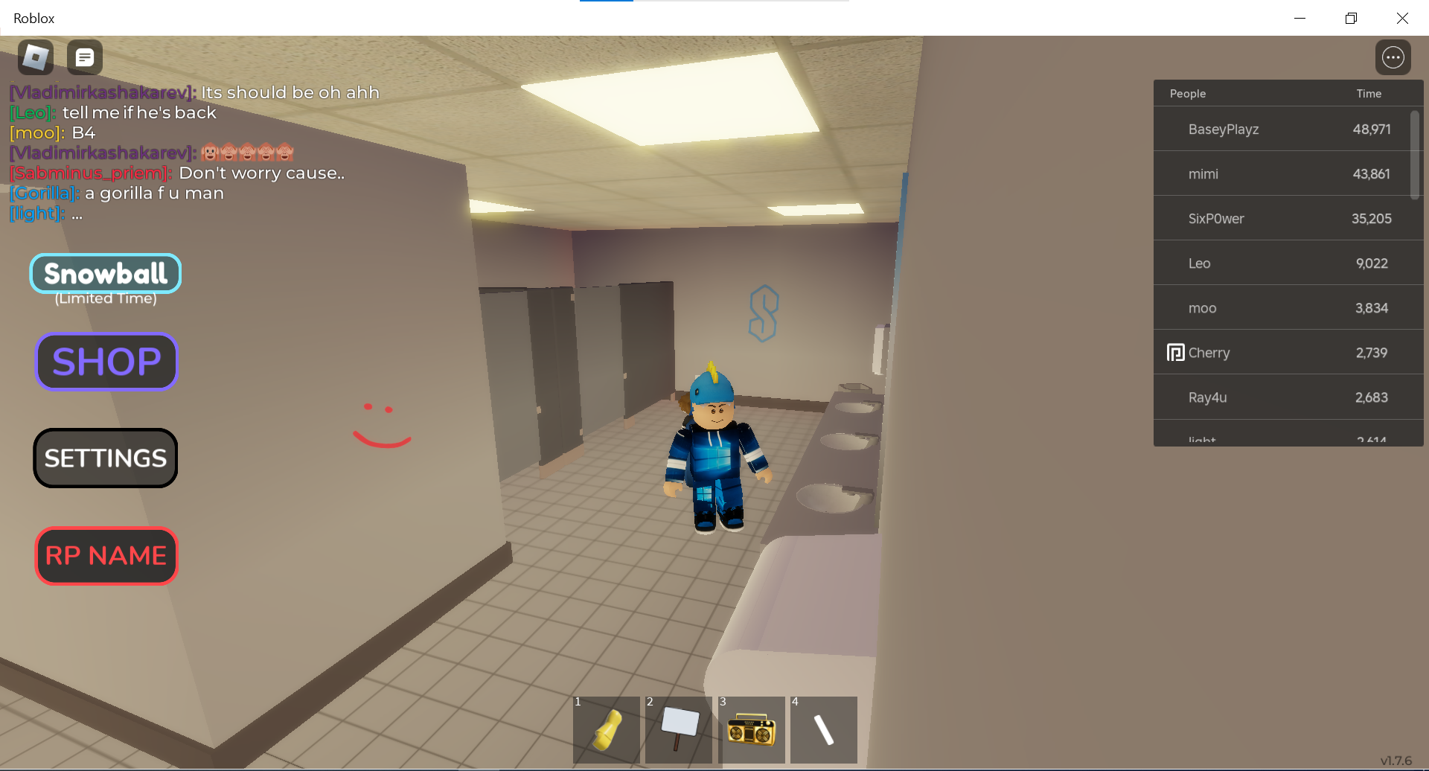

Slide 9
This Photo by Unknown Author is licensed under CC BY-SA-NC

Slide 10
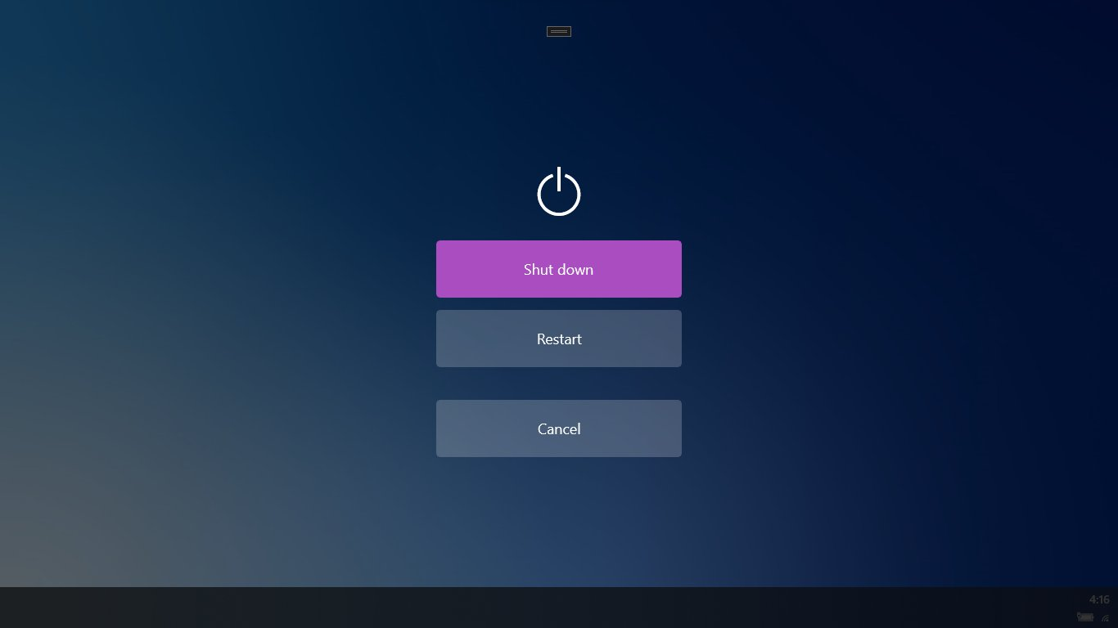
This Photo by Unknown Author is licensed under CC BY-SA-NC

Slide 11


